Slide 1
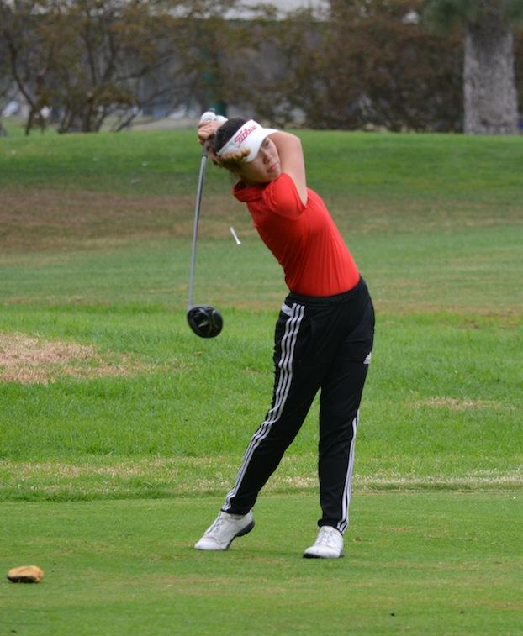
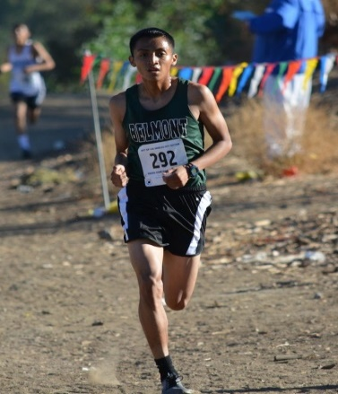
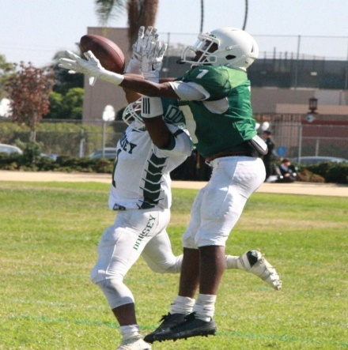
LAUSD ATHLETIC DEPARTMENT ATHLETIC MEETING March 4, 2021
Trenton Cornelius – Coordinator cell (213) 222-5947
Dave Siedelman – Specialist cell (818) 515-1290
Dawn Xitco – Specialist cell (562) 879-1992
LaShanda Younger Sr. Secretary
Schoology Group: Q445-9TBP-XPRP3
Phone: (213) 241-5847
Fax: (213) 241-5846

Slide 2
SCHEDULES
Outdoor Sports | Allowable Competition Start Date | Last Allowable Contest Date
Boys & Girls Golf | March 15, 2021 | May 24, 2021
Swim/Dive | March 15, 2021 | May 22, 2021
Boys & Girls Tennis | March 15, 2021 | May 6, 2021
Track & Field | March 20, 2021 | June 4, 2021
Football | April 9, 2021 | April 30, 2021
Water Polo | March 15, 2021 | March 27, 2021
Soccer | March 15, 2021 | May 8, 2021
Lacrosse | March 15, 2021 | May 19, 2021
Baseball | March 19, 2021 | May 29, 2021
Softball | March 19, 2021 | May 29, 2021

Slide 3
PRACTICE protocol
All coaches and athletes must test negative for COVID-19 within 72 hours prior to entering the campus. A negative test result must be provided weekly.
All coaches and players must pass LA Unified screening protocol prior to entering campus utilizing the health check on Daily Pass App (Power App).
Only outdoor activities permitted (gym, indoor weight room and other indoor areas are off limits until further notice).
All sports will have the following CIF Covid-19 modifications: https://tinyurl.com/5xacab2u
Maintain at least 6 feet of distance between coaches and participants and facilitate physical distancing between participants to the maximum extent possible (e.g., staggered starts instead of mass starts for races).

Slide 4
PRACTICE protocol (cont.)
Larger teams, limit mixing by establishing stable smaller training groups for drills and conditioning.
Stagger start times for each sport to limit group size and duration to not exceed two hours
Face coverings must be worn pre- and post-workout
All students have their personal water bottles labeled
When equipment is shared during an activity, participants perform hand hygiene (wash hands with soap and water or use an alcohol-based hand sanitizer) before play, during breaks, at half time, and after the conclusion of the activity.
Balls or other objects or equipment can be touched by multiple players during practice and play if the above hand hygiene practices are followed.

Slide 5
CAMPUS ENTERING AND EXITING
Signage should indicate the one point of entrance where staff and athletes are required to screen prior to entering campus.
Markers should remind participants of the required 6 feet of social distancing.
A certificated staff member must be present at all times and have access to the Emergency Action Plan and a defibrillator.
Students and staff will need to follow specific traffic patterns to enter and exit the school.
Spectators may not enter campus or line up at check in. They must remain in their car while dropping off or picking up students.
Students should not congregate pre and post practice outside of their team. Students must exit and leave immediately following conditioning.
Hands must be sanitized pre and post conditioning

Slide 6
transportation/Team size
SPORT | Number of Participants | Buses Provided (24 plus 1 coach per bus)
Football | 18 - 48 athletes | 2 buses
XC | 10-21 per gender | 2 buses
Tennis | 10 - 20 per gender | 1 bus per gender
Golf | 5 - 10 per gender | 1 bus
Soccer | 11 - 24 per gender | 1 bus per gender
Baseball | 9 - 24 athletes | 1 bus
Softball | 9 -24 athletes | 1 bus
Track | 10 -24 per gender | 1 bus per gender
Swim | 10- 20 per gender | 1 bus per gender
Water Polo | 10 - 20 per gender | 1 bus per gender
Lacrosse | 10 -20 per gender | 1 bus per gender

Slide 7
Covid - 19 testing
72 hours prior to the first day of practice. Weekly after initial practice. | All coaches and players complete all mandated district COVID screening protocols and testing. Visit https://achieve.lausd.net/covidtesting for information on COVID testing. Testing appointments may be made here: https://achieve.lausd.net/covidtestingappt

Slide 8
SCHOOL-SITE RESPONSIBILITIES
Provide virtual meeting for all student athletes informing them of their responsibilities and schedule. Parents are required to acknowledge their responsibilities on the release form.
Certify all coaches in Principals Portal prior to authorizing any in-person contact
Review all MISIS rosters of student athletes to ensure all participants have a cleared physical (“Clearance Of Student-Athletes For The 2020-2021 School Year”, dated September 10, 2020) and all additional eligibility requirements
Provide PPE and water for athletes and employees upon request
Adhere to LA Unified testing protocols for student athletes, student managers and coaches
Post signage to display all guidelines
Review disinfecting/restocking schedule of restrooms (outdoor weight room, locker rooms) with the plant manager
Provide sound amplification for coaches wearing masks, such as artificial whistles or bullhorns

Slide 9
STUDENT-ATHLETE PAPERWORK
Physical – Every year, must be signed and stamped by Doctor. School Nurse verifies.
Emergency Card – Coach must carry at all times.
Proof of Insurance – hard copy
Bullying and Hazing – signed by athlete and guardian
Concussion - signed by athlete and guardian
Liability Waiver - signed by athlete and guardian
Media Release – signed by guardian
Steroid Abuse - signed by athlete and guardian
Parent Consent – signed by guardian
Code of Conduct - signed by athlete and guardian
Sudden Cardiac Arrest - signed by athlete and guardian
Opioid Abuse - signed by athlete and guardian
COVID-19 Waiver – signed by athlete and guardian
Season 1 rosters are due December 14, 2020

Slide 10
Paid Coaching LAUSD/CIF Requirements
Cleared Fingerprints by both Department of Justice (DOJ) and FBI
Negative TB test or Chest X-Ray
Certificate of passing Coaching Education (Good For Life) Certificate of completion of Concussion Training (every two years)
Sudden Cardiac Arrest Training (every two years) Current CPR Certification (including defibrillator training) (every two years)
Current First Aid Certificate (every two years)
AACCA (Cheerleading Coaches only) (every four years) Water Safety (Aquatic Sports only) (Every two years)
Heat Prevention Illness (all coaches January 1st and every two years thereafter)
Signed Code of Conduct (Annually)
Suicide Prevention Training (Annually)
Child Abuse Certification (Annually)
Covid-19 for Coaches and Administrators
Season 1 Principal Portal Coaches Certification is due: 12/11/20

Slide 11
Volunteer Coaching LAUSD/CIF Requirements
Cleared Fingerprints by both Department of Justice (DOJ) and FBI
Negative TB test or Chest X-Ray
Certificate of passing Coaching Education (Good For Life) Certificate of completion of Concussion Training (every two years
Sudden Cardiac Arrest Training (every two years)
Heat Prevention Illness (every two years)
Current CPR Certification (including defibrillator training) (every two years)
Current First Aid Certificate (every two years)
Volunteer Assistant Coaching Form on file at your school
Signed code of conduct (annually)
Covid-19 for Coaches and Administrators
Volunteer Coaches Certification is due: 12/11/20

Slide 12
COVID-19 EXPOSURE PROCEDURES
People recovering from COVID-19 should not resume exercise until cleared by a physician and will have different paths to return to sports based both on the severity of their illness and their underlying health. A graduated return-to-play/exercise protocol, which introduces and increases physical activity in a stepwise fashion may be warranted and recommended once an athlete has been cleared by a physician.
Utilize the CIF State COVID Graduated Return to Play Protocol (GRTP) Form to ensure student has met all qualifications to return to athletics.
Report all positive test results to school site principal and athletic director immediately.

Slide 13
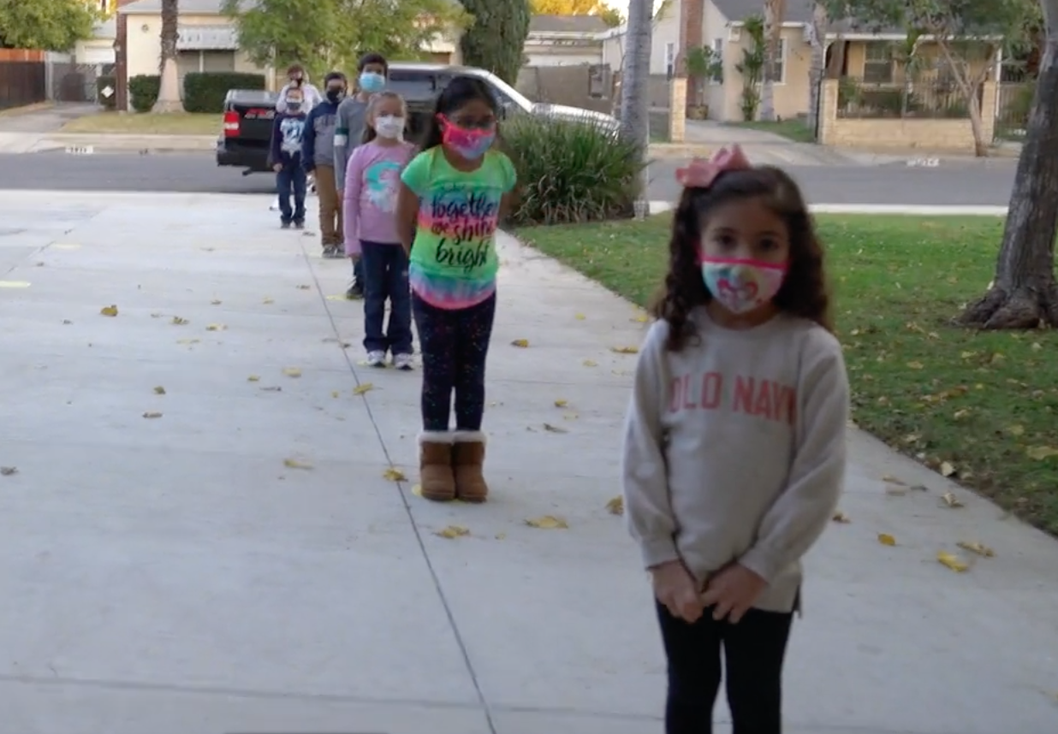

Slide 14
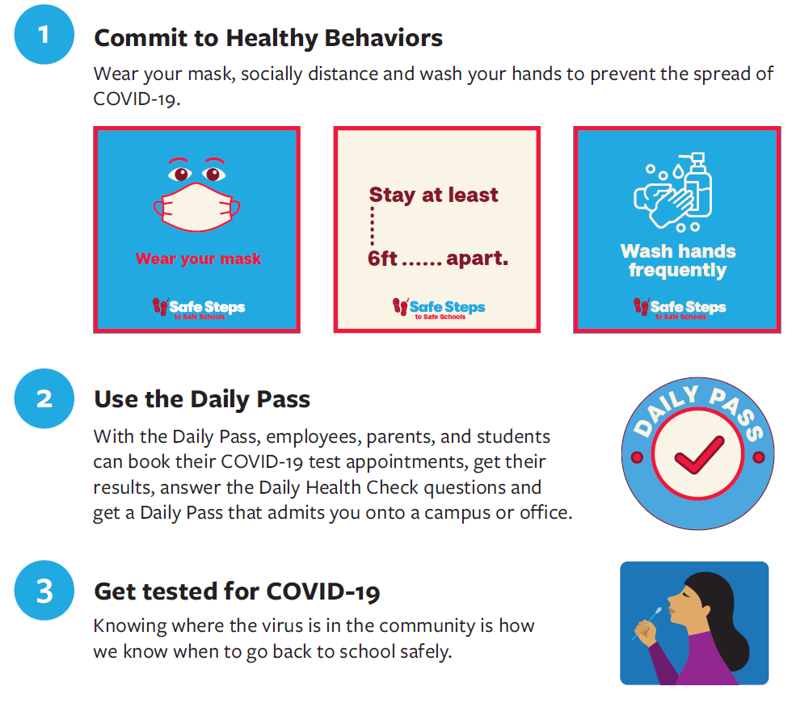

Slide 15
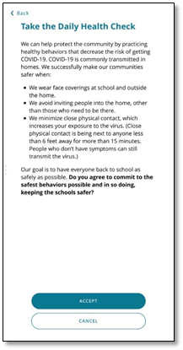
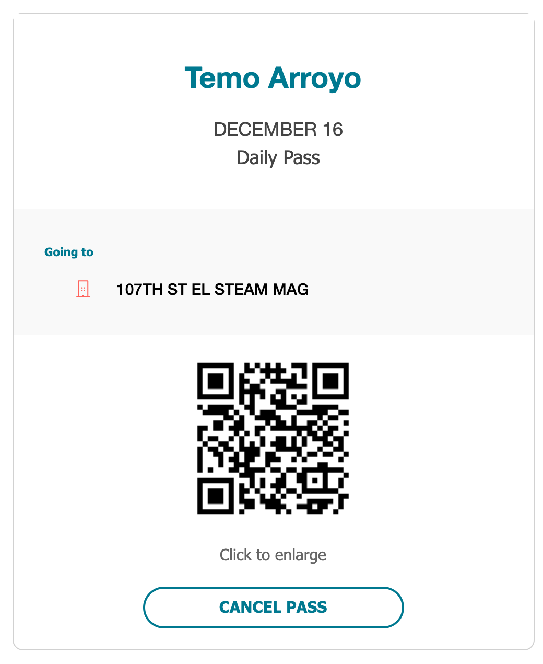
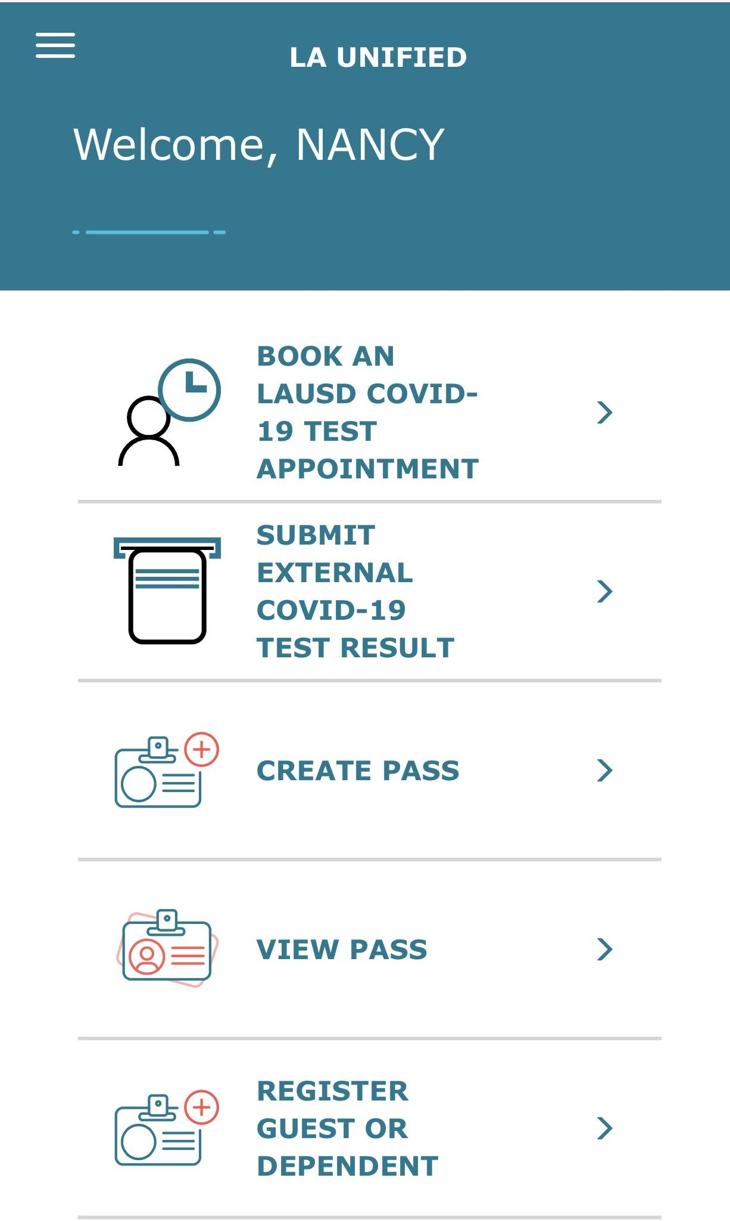
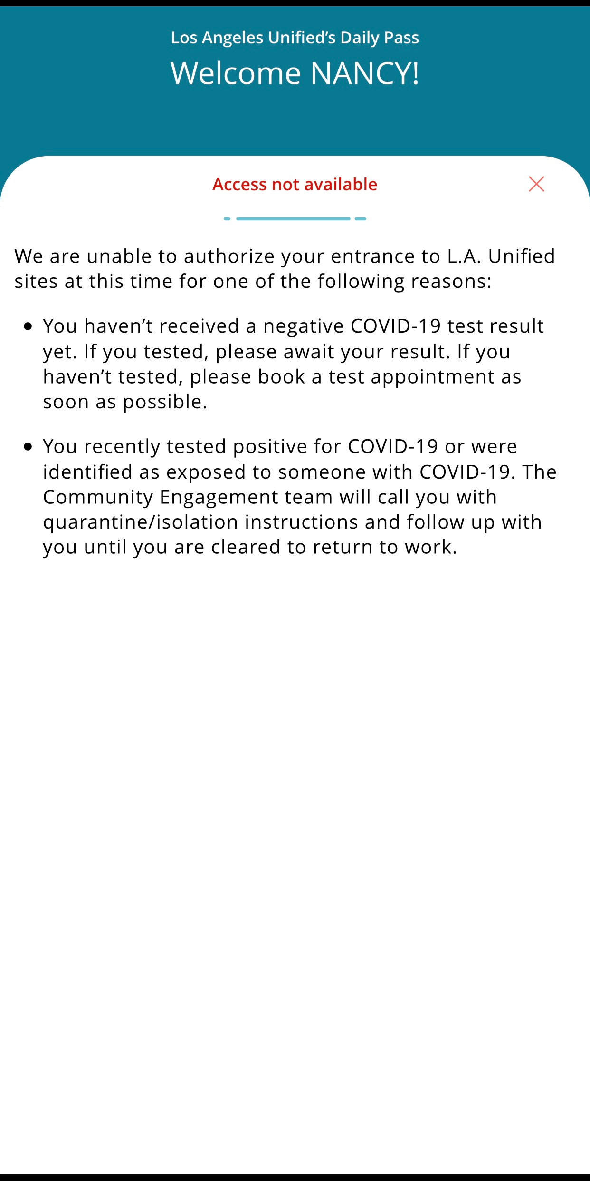
DAILY PASS
ANSWER HEALTH CHECK
RECEIVE A DAILY PASS
QR CODE
BOOK A COVID-19 TEST APPOINTMENT
LINKED TO COVID-19 TEST RESULTS
BOOK VACCINATION APPOINTMENTS
DailyPass.lausd.net

Slide 16
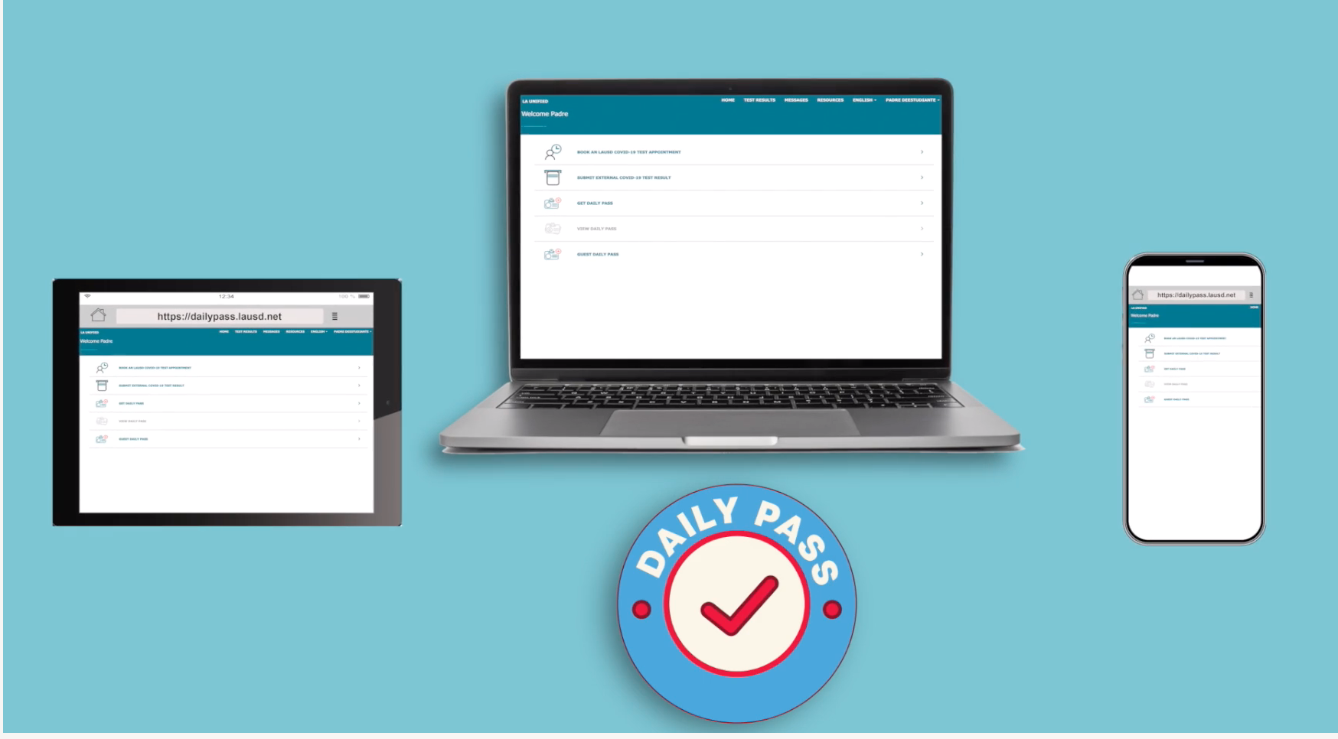
DAILY PASS ACCESSIBLE ON A TABLET, LAPTOP OR CELL PHONE

Slide 17
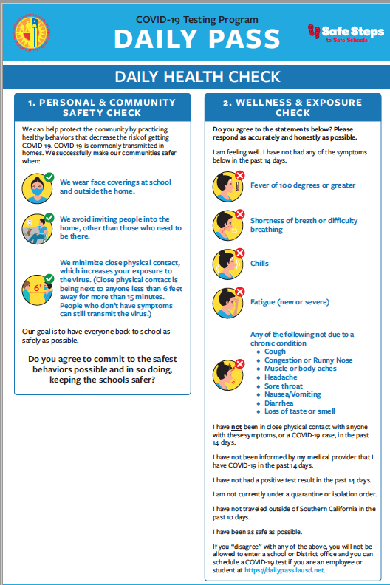
DAILY PASS HEALTH CHECK - AT HOME

Slide 18
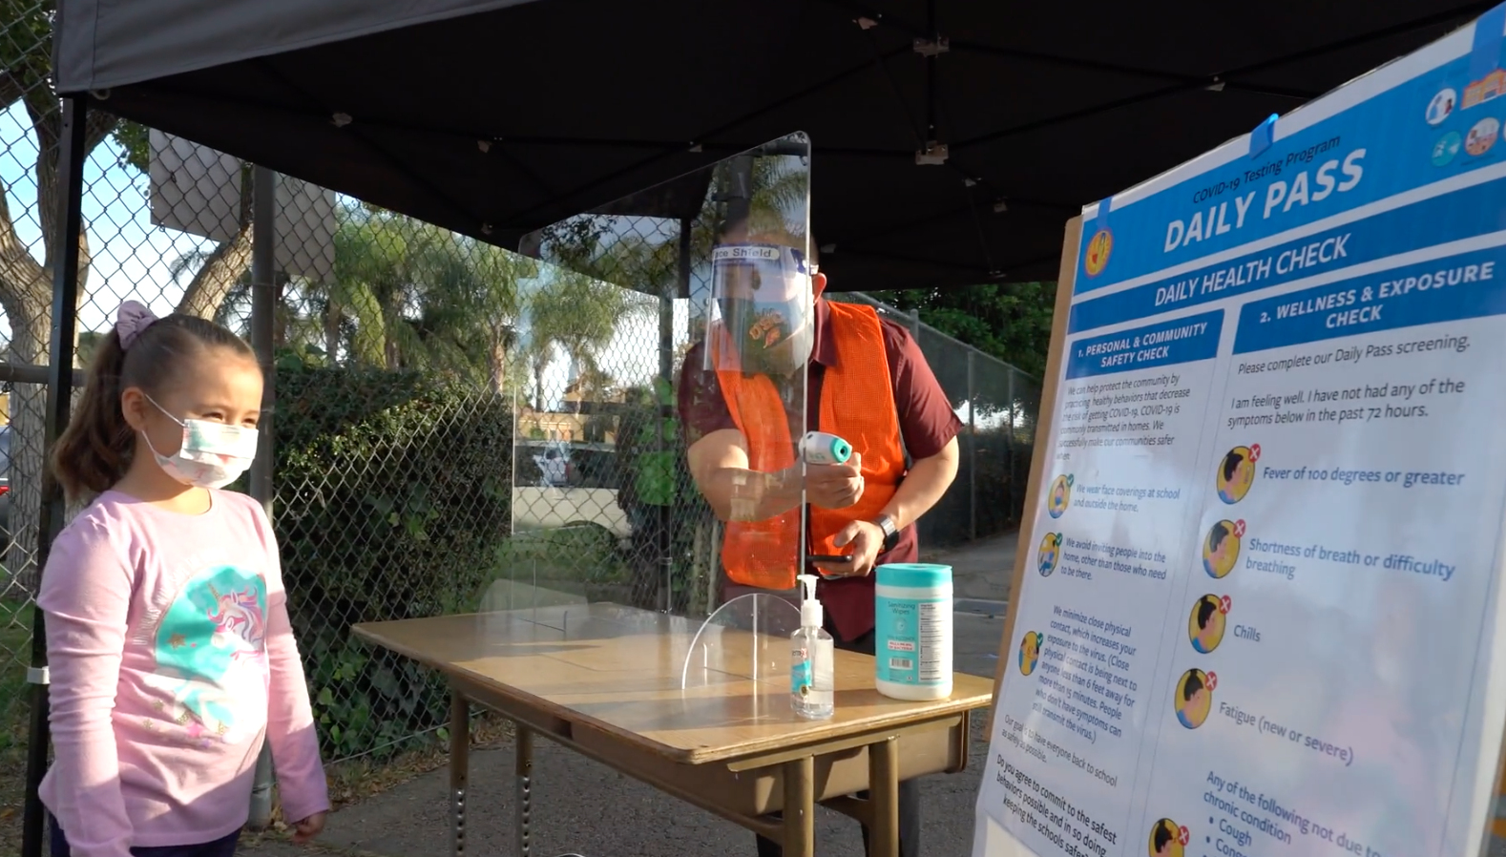
DAILY PASS HEALTH CHECK - IN-PERSON

Slide 19
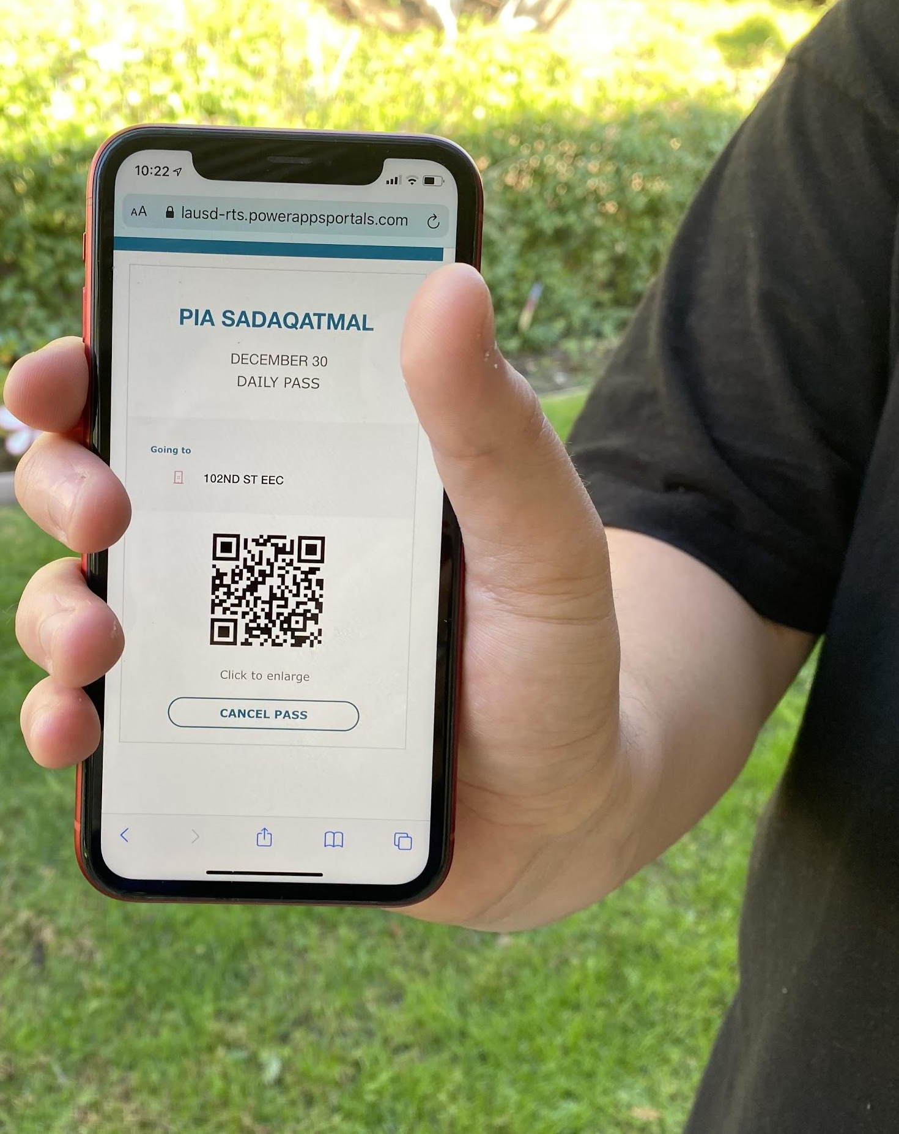
A QR CODE WILL BE GENERATED WHEN GIVEN A DAILY PASS
Name
Date
Correct Site
dailypass.lausd.net

Slide 20
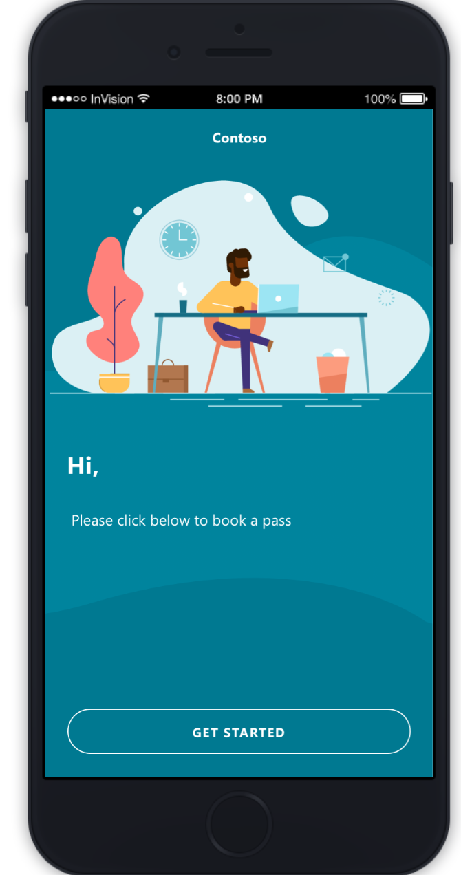
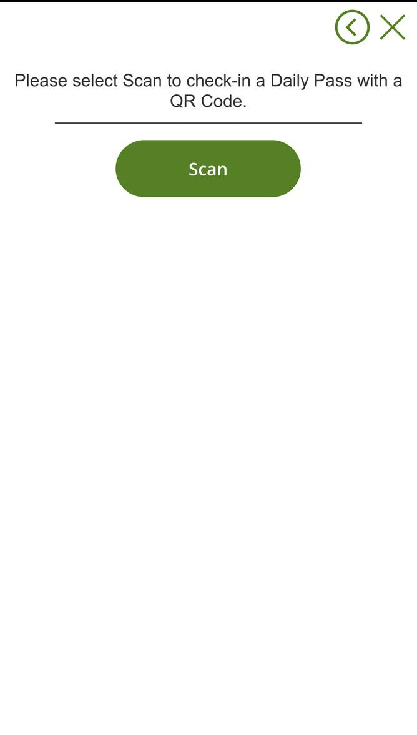
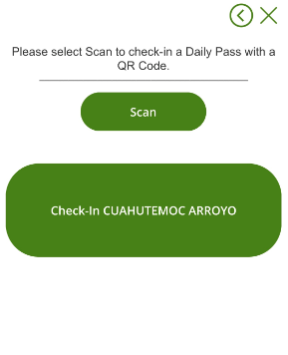
SCAN QR CODE WITH DAILY PASS SCANNER IN POWER APPS
Welcomer will utilize the Daily Pass Scanner to scan Daily Pass QR codes to get individuals checked-in.
Welcomer will ONLY check-in individual’s whose temperature is in the normal range
Power Apps

Slide 21
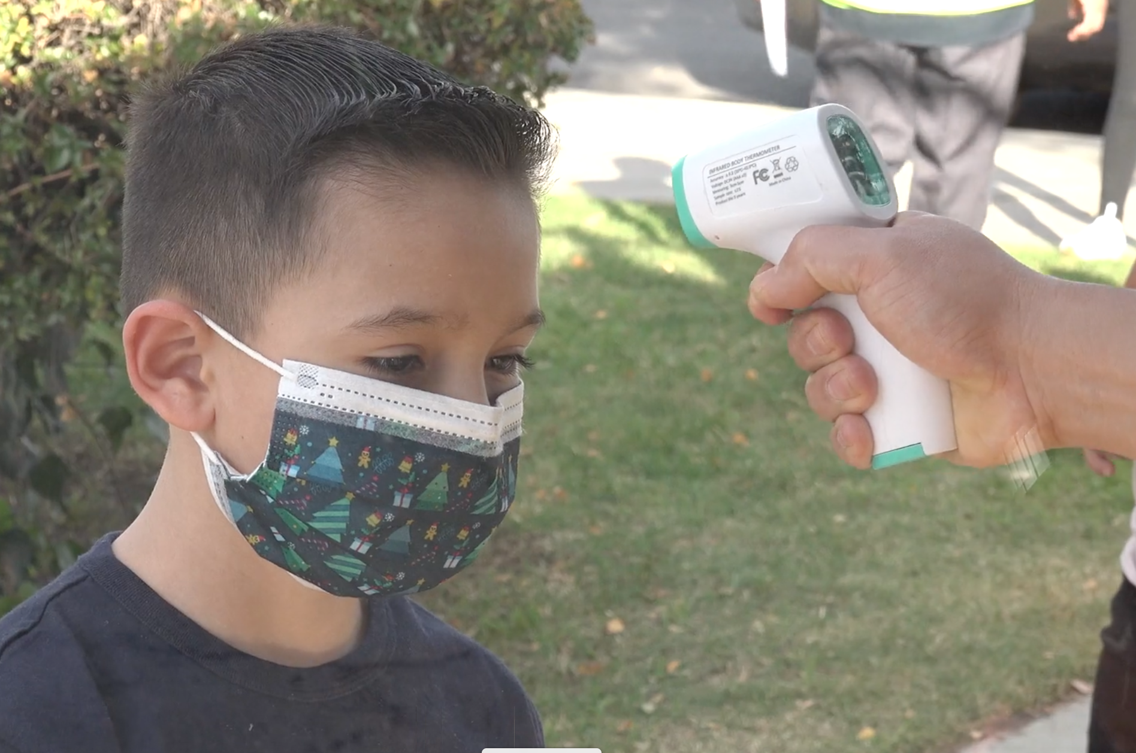
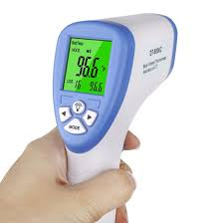
CHECK-IN AREA: TEMPERATURE CHECK
Entry allowed to individuals whose temperature is 99.9℉ or less
Proper use of a face mask is required before entry
No-contact infrared thermometer

Slide 22
IMPORTANT INFORMATION
Students 13 years and older can use the Daily Pass
A negative test needs to be in the system for students and employees to get a Daily Pass QR Code
Testing appointments need to be scheduled using parent portal accounts; otherwise test results will not be linked to the students record
Students under 13 years of age need to have the parent or guardian do the health check in the Daily Pass

Slide 23
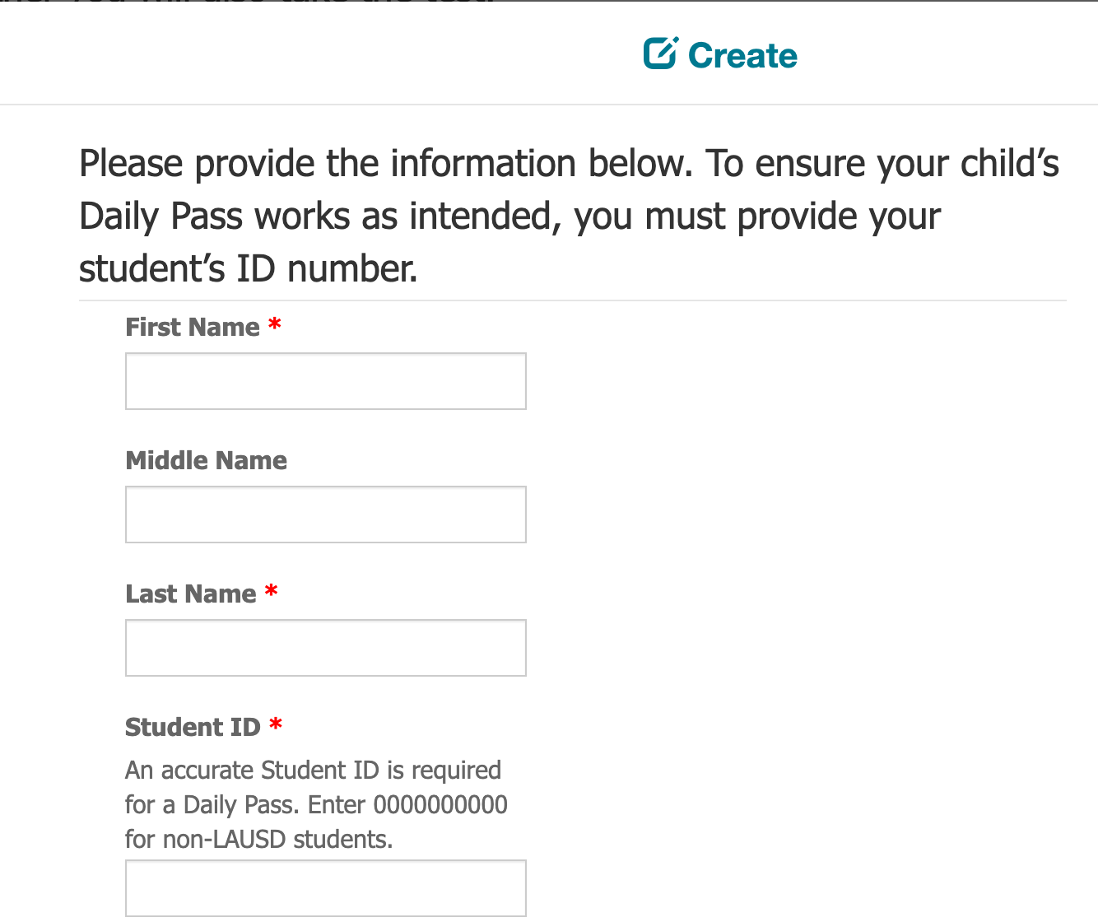
IMPORTANT INFORMATION
Please make sure you book your child’s COVID-19 test appointment using their student ID number.
If the student ID number is not provided, the student’s Daily Pass will not be linked with the test results.

Slide 24
IMPORTANT INFORMATION
Daily Pass is connected to your COVID 19 test results
Students and employees who test positive will not be able to get a Daily Pass QR Code until they have finished their isolation period.
The District has a Community Engagement team that clears students and employees after they have tested positive for COVID.
The information collected in the Daily Pass is available to the Community Engagement team and school administrators and supervisors. This information will be used to ensure that students, employees can return to school after they have have tested positive for COVID.
Notes:
The following are important informations points you need to know:
The Daily Pass is available to all Los Angeles Unified employees, students 13 years and older, parents and visitors.
A negative COVID 19 test must be in the system for a student or employee to obtain a Daily Pass QR Code
Parents will need to login using their Parent Portal accounts. In order to link your account to your children you will need Student ID and PIN. Call your school or call the hotline (213) 443-1300. A letter was sent during the Winter Break to all parents with this information.
Daily Pass is available for students 13 years old and over to answer the health check questions. Only students 18 years and older can book their COVID-19 test appointment and view their test results.
The Daily Pass is linked to your COVID 19 test results so employees and students who test positive or submit external test results to the Community Engagement team will not be able to get a Daily Pass QR code until they have completed their isolation period and they are cleared to return to school or work by the Community Engagement team. Their Daily Pass will be enabled to generate a QR code when the Community Engagement team closes that individual’s case.
The data collected in the Daily Pass is accessible to the Community Engagement team to ensure all those who test positive and are exposed are contacted. In addition, administrators and supervisors will be able to view the data in a dashboard to ensure their campus or office is as safe as possible.
LAUSD is in the process of providing the Vaccine to those who are eligible based on the LA County Health requirements. Through the Daily Pass the vaccination appointments will be available to those that are eligible.
Using the Daily Pass to return to school or work should be easy, you’ll be able to schedule your COVID-19 test, get your test results, answer the Daily Health Check questions and receive a QR code, which will allow you to get checked-in faster when you arrive to school or work.
The Daily Pass Health Check includes asking visitors, employees and students to commit to healthy behaviors, as well as answering the required LA County Department of Public health questions that check for wellness and recent exposure to the virus.
Part of the check-in process for anyone entering a school or office will also include a temperature check.

Slide 25
DAILY PASS VIDEO
Notes:
Notes:
Daily Pass PSA https://lausd.wistia.com/medias/39dubuwinq
(run time = 1:22)
Video Transcript
DAILY PASS PSA SCRIPT
Welcome to the Daily Pass - the one-stop shop to gain entry to a Los Angeles Unified school campus or District office.
This tool, which was developed for Los Angeles Unified in partnership with Microsoft, allows individuals to answer daily health check questions, receive a Daily Pass QR code, schedule a COVID-19 test as well as receive test results and reminders.
The Daily Pass is available to all Los Angeles Unified employees, students, parents and visitors via their computer, tablet or any mobile device.
To obtain your Daily Pass, which follows guidelines set forth by the LA County Health Department, simply go to https://dailypass.lausd.net and login using your District email address. Parents will need to login using their Parent Portal account.
Click Get Daily Pass
Select the person for whom you are creating a pass
Choose the campus or office you will be entering from the drop down menu.
Take the daily health check and if you are cleared, a QR code will be generated for that date and site.
Upon arrival at the school site, a school staff member, known as a welcomer, will scan the QR code at entry and take your temperature.
Thank you for using the Daily Pass as we take every step to ensure we keep our school and workplace as safe as possible.

Slide 26
Questions/Concerns

